Slide 1


CS3006:
INTRODUCTION TO DATA SCIENCE FOR ENGINEERS
SHAPE
RECOGNITION
CS22B1090
Shubh Khandelwal

Slide 2


INTRODUCTION
The project mainly focuses on the detection and classification of three basic shapes: circle, square and triangle.
The project mainly applies some preprocessing to the received image and compares its features, namely corners, circularity and Hu moments.
The project then classifies the image based on the minimum distance from the mean of the features of each of the basic shapes and compares the distance with a certain threshold for accurate classification.

Slide 3

MODEL TRAINING
The model training phase consisted of analyzing the presence of some common features across the labelled dataset of shapes to get their means.
These means will function as the centroids for features that can be tracked across a variety of images. The features of all the images are stored in separate files.

Slide 4

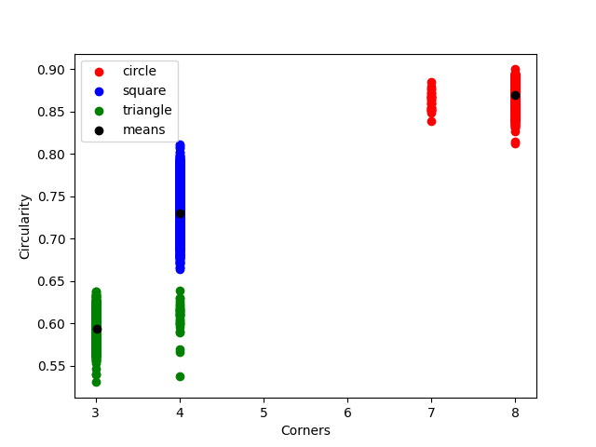
DATA DISTRIBUTION:
SCATTER PLOT

Slide 5

DATA TESTING
The common features are repeatedly checked against mean and only those above a certain threshold are classified.
The error cases are assigned to the specific section in the confusion matrix, thus calculating the accuracy of the model.
The correlation between the columns has been measured and the columns with high correlation values are allowed to act as a weighted measurement unit.

Slide 6
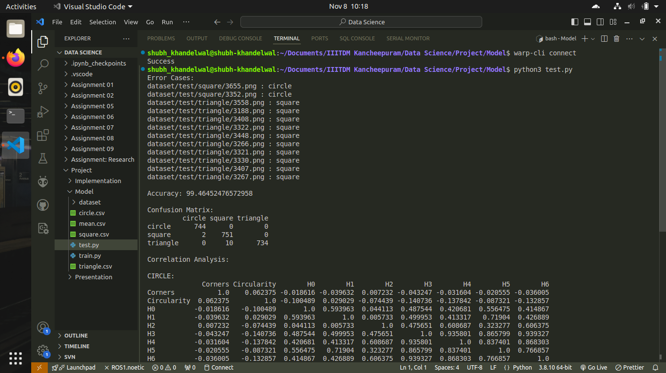
ACCURACY:
CONFUSION MATRIX

Slide 7
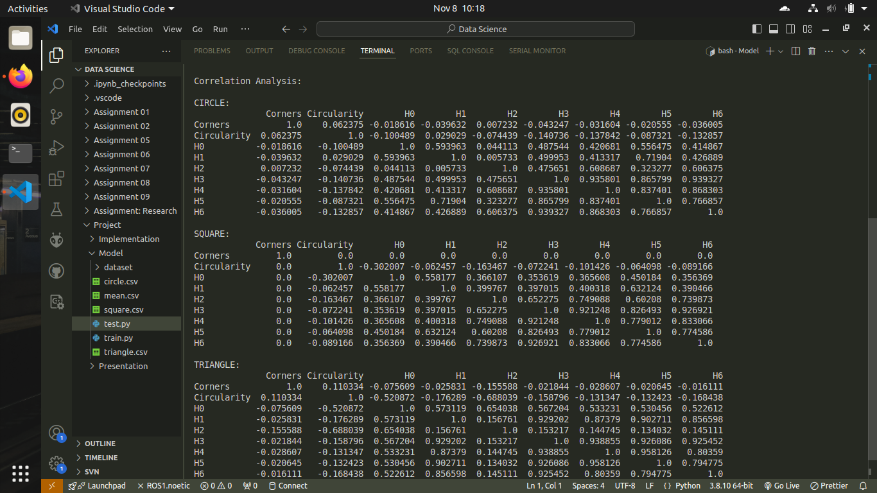
ANALYSIS:
CORRELATION

Slide 8
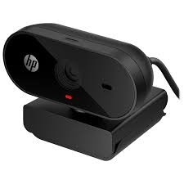
IMPLEMENTATION
For real-time analysis of images, an average webcam can be used to review the shapes detected.
The implementation of the camera publisher code has been done in C++ using Robot Operating System (ROS) because of its low latency.
The image handling part is handled by Python due to the presence of multiple ready-to-use in-built libraries.

Slide 9

THANK YOU
CS22B1090
Shubh Khandelwal

